Slide 1

Matrix Multiplier - An Analog Approach
Project done by,
Dhiman Sarkar (19101105086)
Rama Tung (19101105090)
Ramprasad Satpati (18101105062)
Sambhu Show (18101105063)
Yogesh Jha (18101105041)
Department of Electronics and Communication Engineering
Jalpaiguri Government Engineering College
Denguajhar, Jalpaiguri, WB 735102, IN
Under the supervision of
Prof. Shampa Karmakar

Slide 2

]
[
[$\text{Abstract}$]
Our project presents an alternative approach in doing matrix multiplications. As of now, matrix multiplication or most of the numerical calculations are done by digital computers. Digital computers takes a noticeable time when calculating large volume numerical calculations. But in our analog electronics based approach, the computation time could be reduced drastically.

Slide 3
]
[
[Acknowledgement]
First and foremost, we are grateful to Prof.(Dr.) Jishan Mehedi, HOD, Department of Electronics and Communication Engineering, Jalpaiguri Government Engineering College, and all other faculty members of our department for their constant guidance and support, constant motivation and sincere support and gratitude for this project work. We owe a lot of thanks to our supervisor, Prof. Shampa Karmakar, Professor, Department of Electronics and Communication Engineering, Jalpaiguri Government Engineering College, for igniting and constantly motivating us and guiding us in the idea of a creatively and amazingly performed Major Project in undertaking this endeavor and challenge and also for being there whenever we needed her guidance or assistance.
We would also like to take this moment to show our thanks and gratitude to one and all, who indirectly or directly have given us their hand in this challenging task. We feel happy and joyful and content in expressing our vote of thanks to all those who have helped us and guided us in presenting this project work for our Major Project.

Slide 4
[
]
[Introduction]
Matrix Algebra is a very useful tool for any Science or Engineering field. We often need to analyze the state, behavior of a system and its interaction with other system, by doing matrix multiplications.
In comparison between CPUs, GPUs and Digital ASICs, ASICs may perform better than CPU and GPU but still it utilizes many clock cycles for various non-numerical operations.
So, In this regard, we want to propose a different approach in doing Matrix Multiplication. This approach can reduce the computation time drastically.

Slide 5
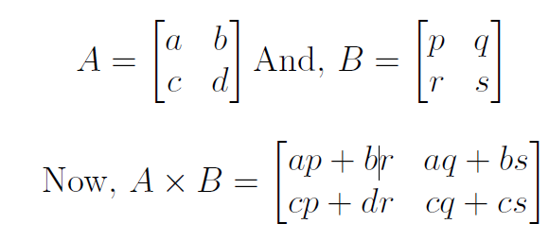
[
]
[Methodology]

Slide 6
[
]
[Methodology]

Slide 7
[
]
[Circuit Description]
(A+B)² - (A-B)² = 4AB

Slide 8
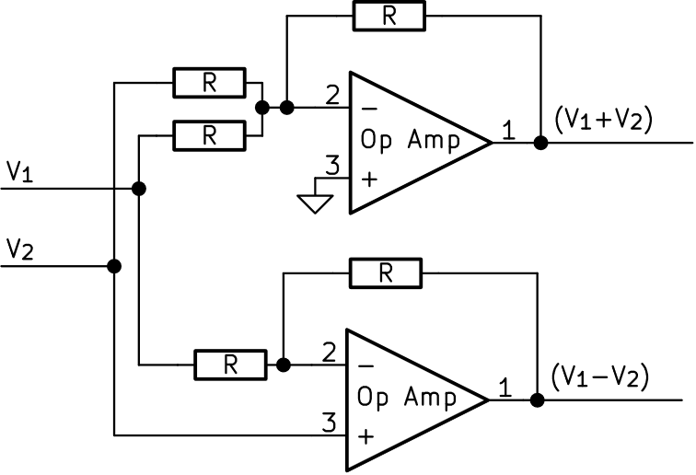
[
]
[Circuit Description]
Generating (V1 + V2) and (V1 − V2)
(A+B)² - (A-B)² = 4AB

Slide 9
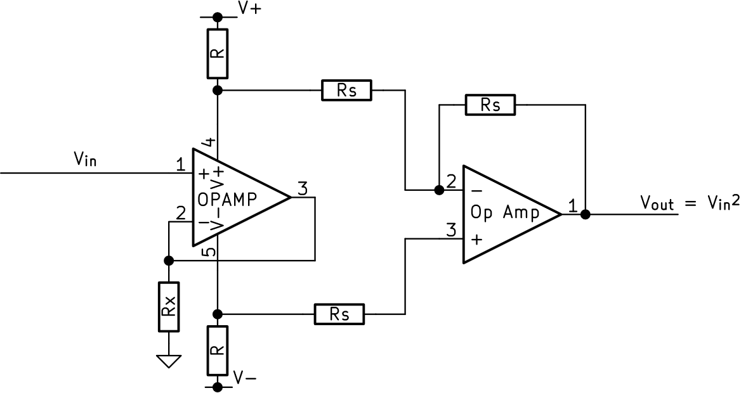
[
]
[Circuit Description]
Squaring Circuit
(A+B)² - (A-B)² = 4AB
We have exploited the behavior of Class AB push-pull output stage of OpAmps.^{[1] [2]}
[1] Surakampontorn W, IEEE Trans Inst & Meas, 37 (1988) 259.
[2] Wandee Petchmaneelumka et. al. Analog multiplier using operational amplifier. KINTEX, Gyeonggi-Do, Korea, June 2005

Slide 10
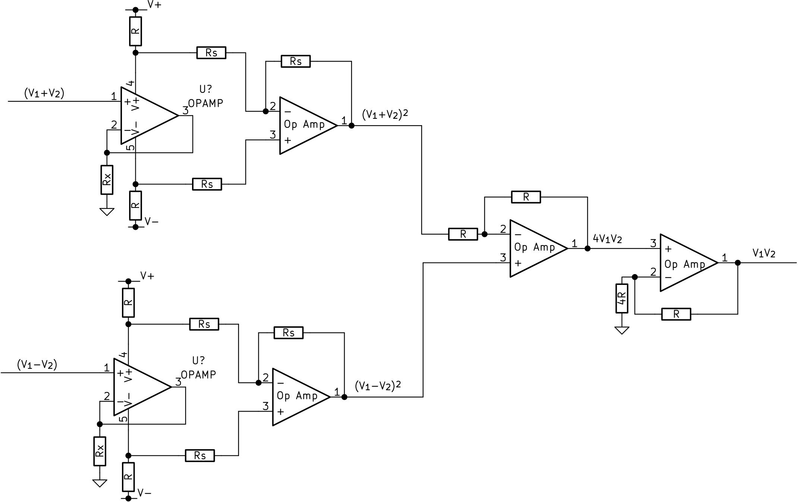
[
]
[Circuit Description]
Generating V₁V₂
(A+B)² - (A-B)² = 4AB

Slide 11
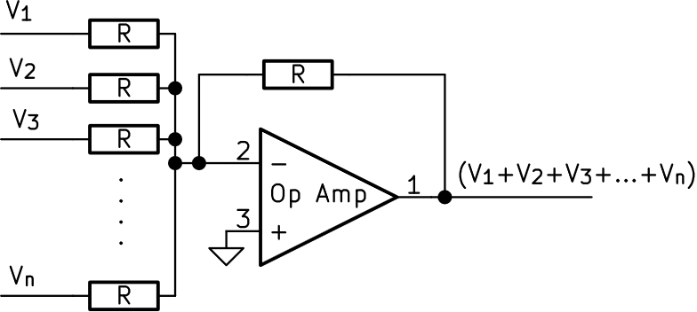
[
]
[Circuit Description]
Adder Circuit

Slide 12
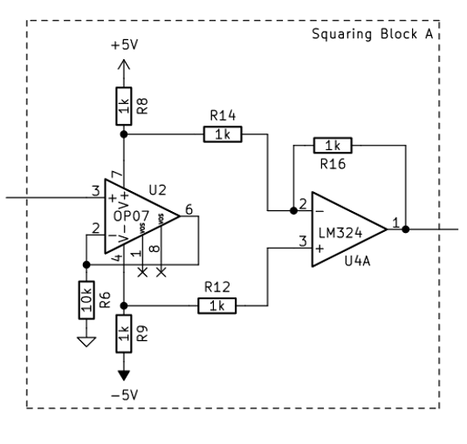
[
]
[Experiments and Results]
Squaring Block Test Schematics

Slide 13
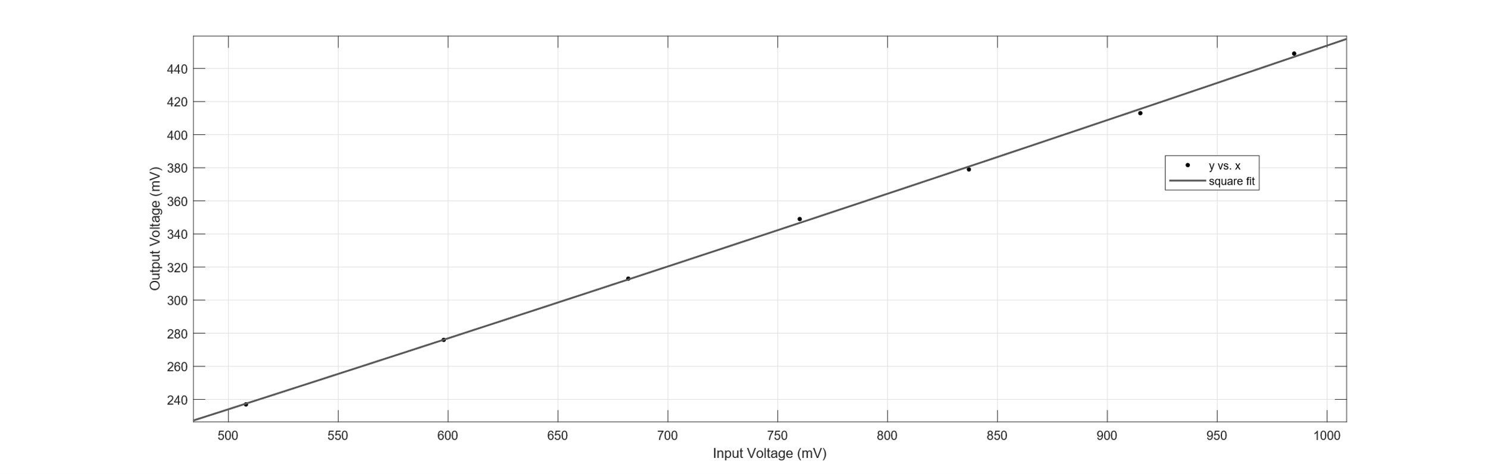
[
]
[Experiments and Results]
Squaring Block Test Results
 | Input Voltage (V_{in}) (mV) | Output Voltage (V_{out}) (mV)
1 | 508 | 237
2 | 598 | 276
3 | 682 | 313
4 | 760 | 349
5 | 837 | 379
6 | 915 | 413
7 | 985 | 449

Slide 14
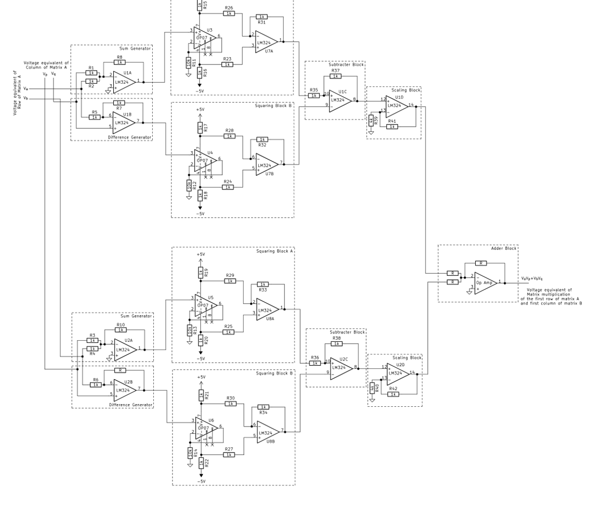
[Experiments and Results]
[
]
Matrix Multiplication (Partial): Full Test Schematics

Slide 15
[
]
[Observations and Conclusion]
So what we have observed is that the circuit behaves as it should.
Component tolerance and device matching is a key factor in getting a undistorted output.
Input voltage range is quite limited for the desired behavior.
We'll have to use a very high resolution and ultra-low noise DAC.
The output is heavily dependent upon environmental conditions and natural variability.
This is more suitable for those applications where the precision is not so important.
So from our observations, we may conclude that the this approach of doing matrix multiplication could be an alternative to the digital computation.

Slide 16
[
]
[Future Scopes]
This approach could find its way to every scientific applications because of its real-time numerical ability. In particular AI/ML is a great area for the application of this technique. Real-time object detection, speech recognition could be useful for the differently-able persons. This can also help to take instant decisions based on objective measures and could thousands of lives.
In addition to this, a full fledged Analog Processing Unit which can do other mathematical calculations than just matrix multiplication such as solving partial differential equations could revolutionize the numerical methods and computational power.

Slide 17
Project Presentation in partial fulfillment of the requirements for the award of the degree of Bachelor of Technology in Electronics and Communication Engineering.
Matrix Multiplier - An Analog Approach
1 0
0 You
Thank 1
Department of Electronics and Communication Engineering
Jalpaiguri Government Engineering College

Slide 18
End of Presentation

